Slide 1
New York & Toronto

Slide 2
Introduction
Nowadays, more and more people move to big cities, because those cities are more diversified, more convenient, and there are more job opportunities. Before moving, people want to know the living environment, so as to decide where is more suitable for living when there are multiple choices. I will explore New York City and the city of Toronto and compare the neighborhoods of the two cities and determine how similar or dissimilar they are. These two cities are the financial capitals of the U.S. and Canada respectly. By comparing the two cities can reflect the characteristics of the two. Thus, it can provide background information and suggestions for people who want to move.

Slide 3
Data
The data contains postal code, boroughs, neighborhoods, latitude and longitude.
Source of the data:
https://cocl.us/new_york_dataset
https://en.wikipedia.org/wiki/List_of_postal_codes_of_Canada:_M
https://data.cityofnewyork.us/api/views/2fra-mtpn/rows.csv?accessType=DOWNLOAD
https://prod-hub-indexer.s3.amazonaws.com/files/af500b5abb7240399853b35a2362d0c0/0/full/26717/af500b5abb7240399853b35a2362d0c0_0_full_26717.csv

Slide 4
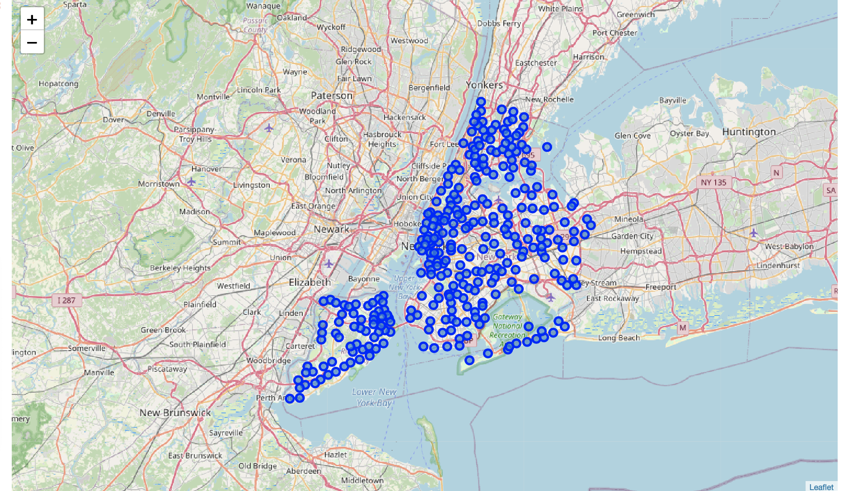
Map of New York

Slide 5
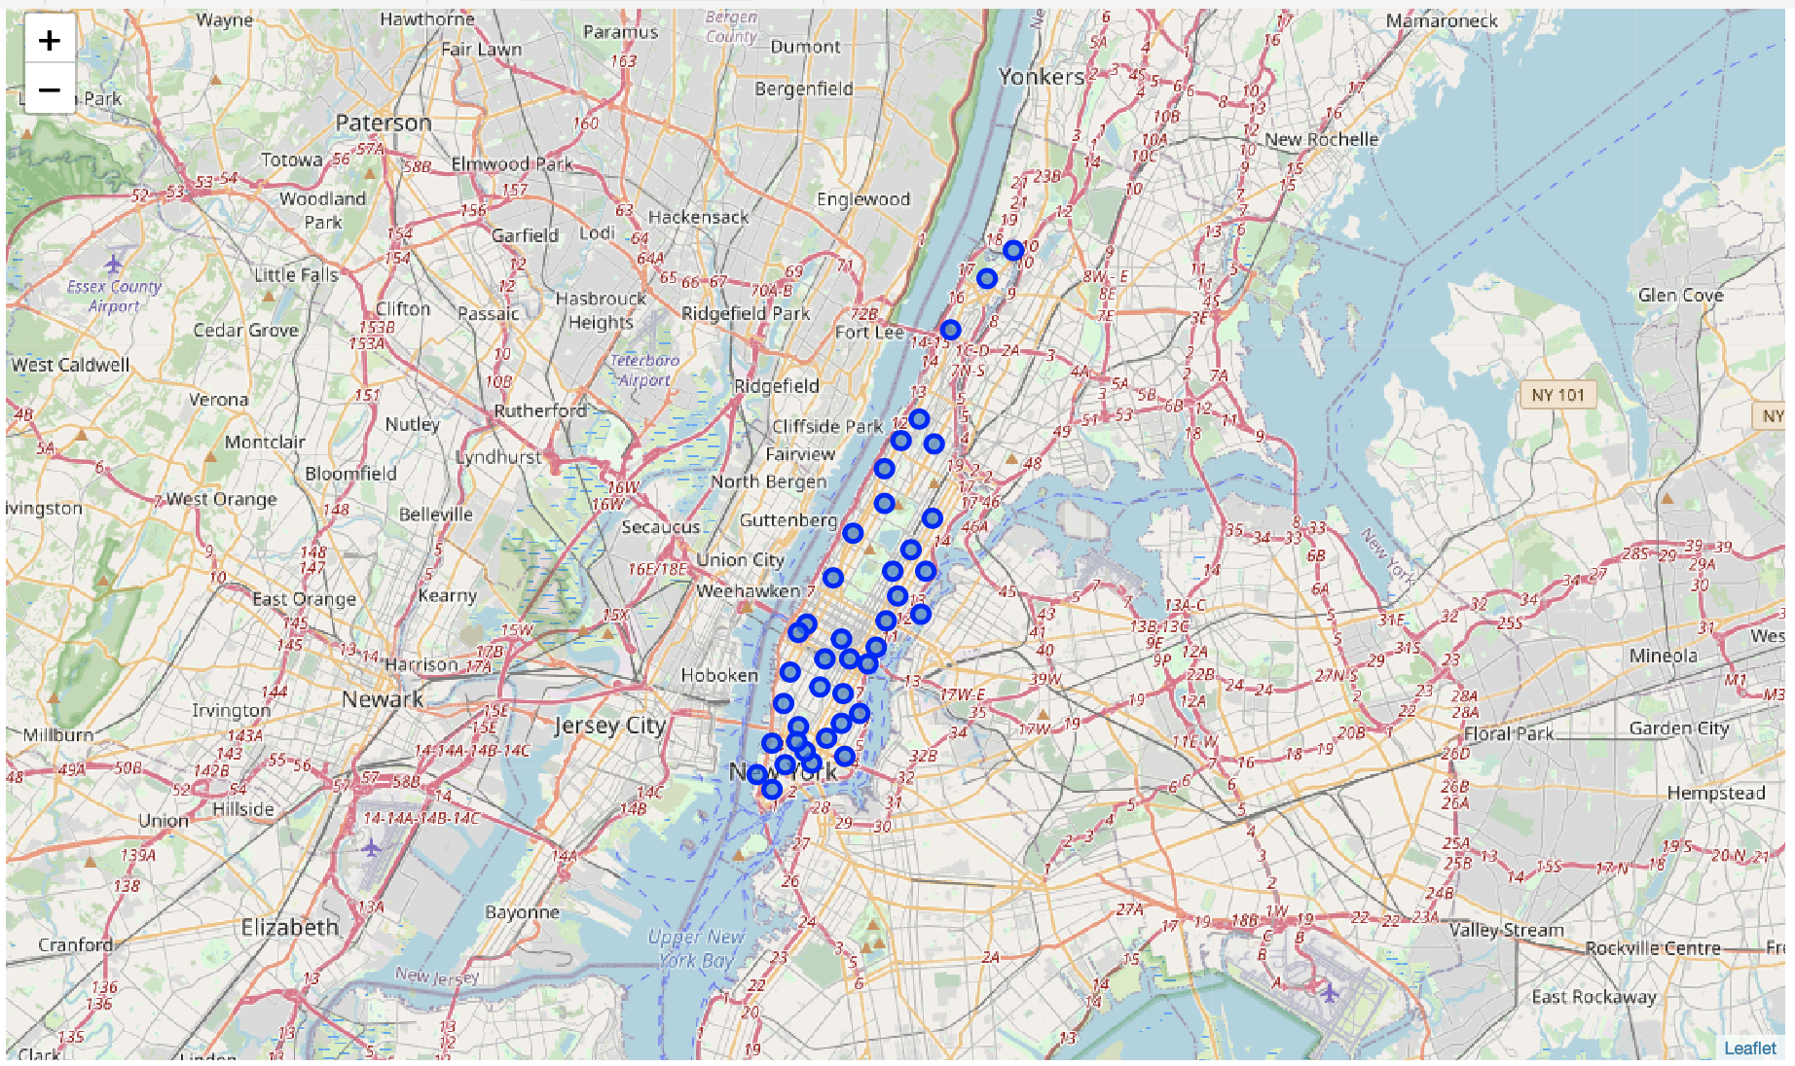
Map of Manhattan

Slide 6
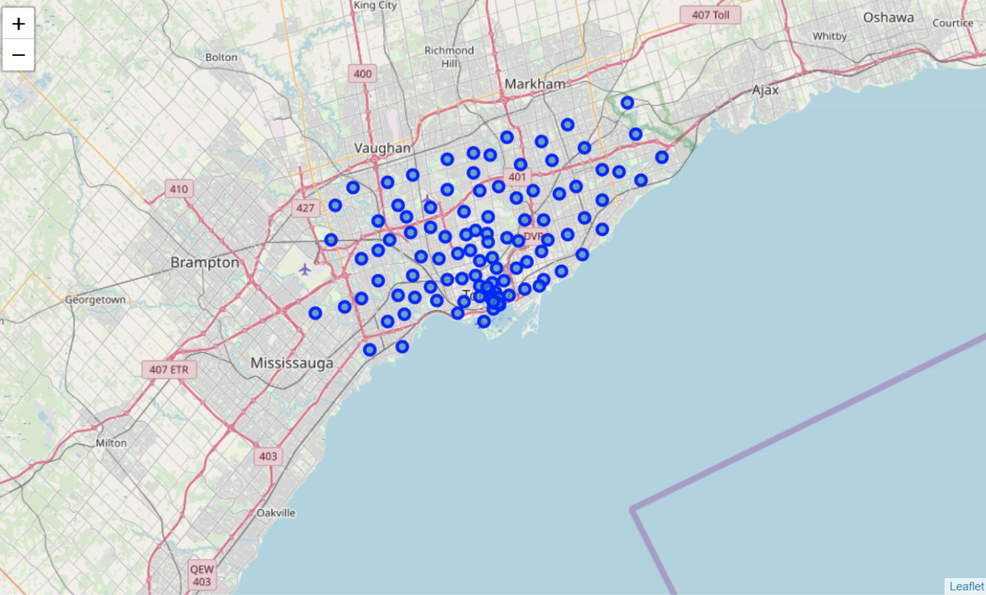
Map of Toronto

Slide 7
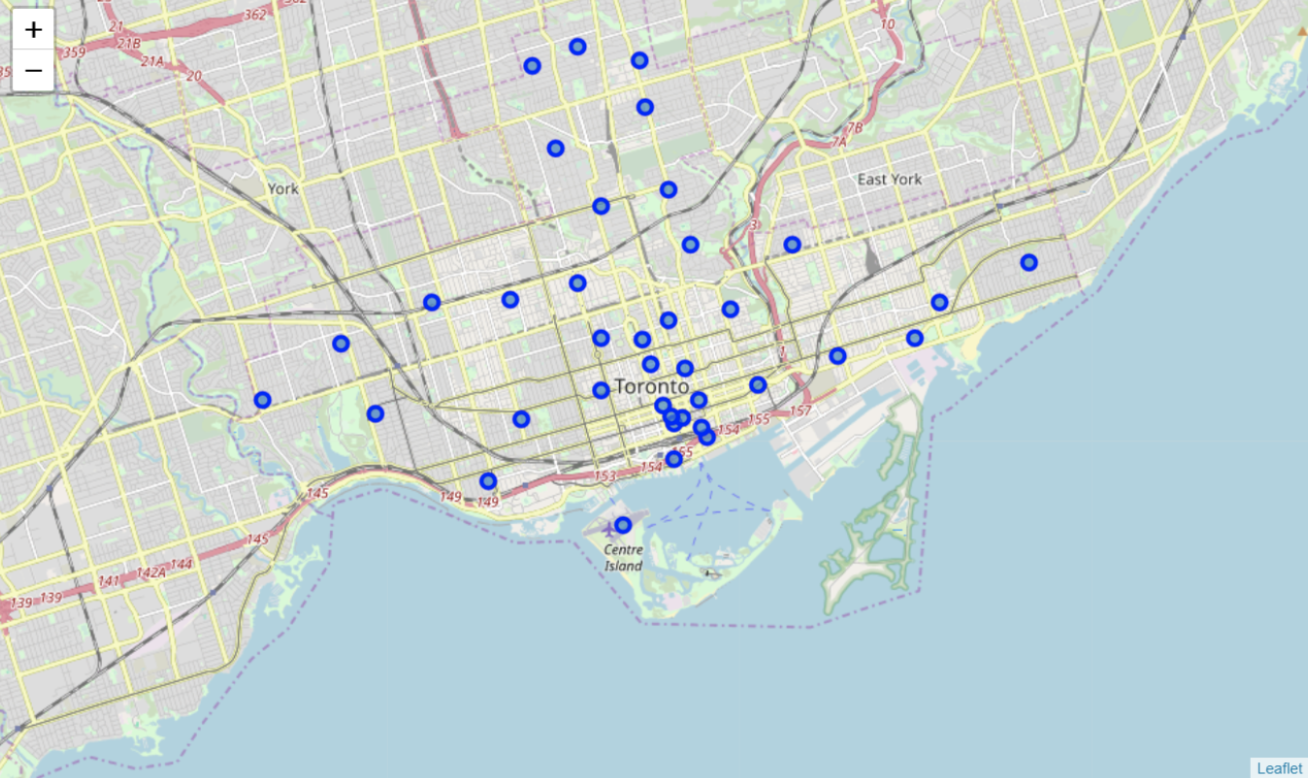
Map of East, Central, West, Downtown Toronto

Slide 8
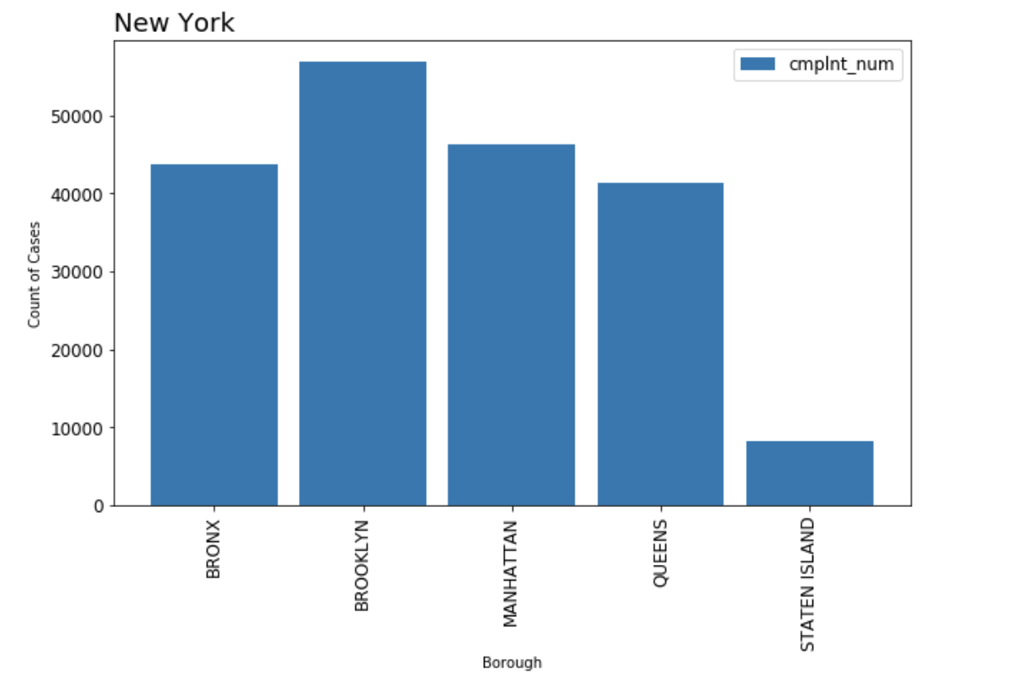
New York Crime Rate

Slide 9
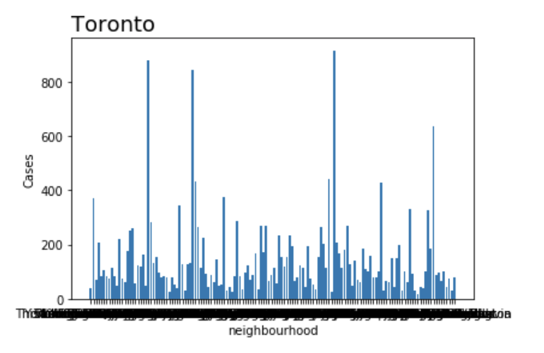
Toronto Crime Rate

Slide 10
Conclusion
The graphs show where the boroughs are, so the people can easily find which location they are interested in. And, the bar chart shows the crime rate in different boroughs and neighborhoods so that they can know where is safer. So, it can give people some suggestions.

